Slide 1
8 Puzzle Problem
By: Keval Solanki, Sidharth Anandkumar, Ahmed El Maliki

Slide 2
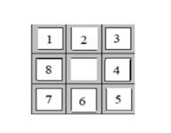
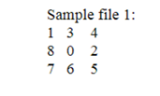
Problem Description
The problem given was that there is an 8-puzzle game with tiles in it
The tiles were numbered from 0-8
There is an empty spot with no tile and you can move up, down, left or right
There is a initial state and a final state
Starting State
Final State

Slide 3
Our task
The goal is to go from the initial state to the final state while using 3 different algorithms
Breadth First Search
Depth First Search
Dijkstra’s Algorithm
Our task is to implement the 3 algorithms and compare the different implementation to come up with one that take that takes the least number of steps to reach the final state

Slide 4
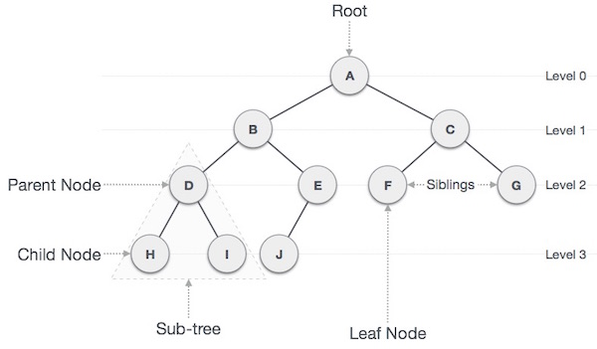
Implementations - Breadth First Search
The BFS algorithm was implemented using the C++ language
To implement the algorithm, a tree data structure was utilized
The tree consisted of nodes that ranged from the parent to the child

Slide 5
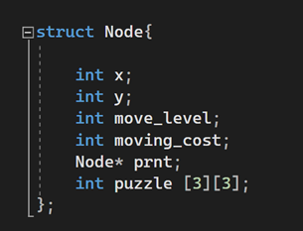
Implementations - Breadth First Search
A struct was used to create the node
Each node represented a different state of the puzzle
Each node had a multidimensional array that represented the matrix
A pointer to the parent node and 2 int that held the level and move cost

Slide 6
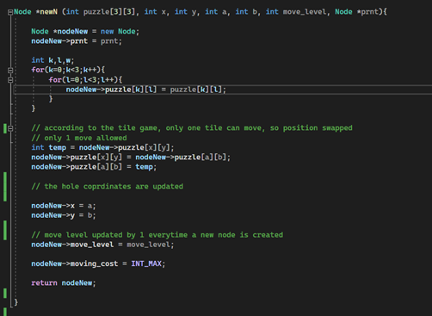
Implementations - Breadth First Search
A helper function was used to create new nodes which indicate states.
This function updates the hole coordinates after the moves in the puzzle .
Updates the move levels too.

Slide 7
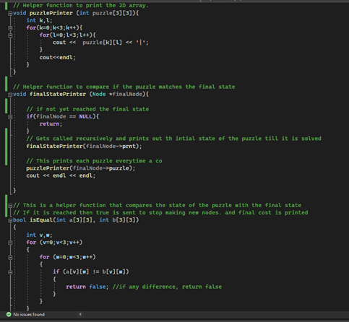
PuzzlePrinter() iterates through 2d array and prints it as a matrix
finalStateprinter()
Recursive function that only returns after solution of the puzzle has been found and then calls PuzzlePrinter() to print every single node in order of the solution
isequal(): Constantly check state of the puzzle with the final state desired, if reached it will send a bool val to stop solving the puzzle()

Slide 8
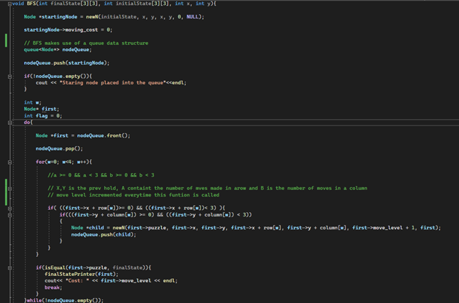
Function that uses QUEUE data structure to pop and push nodes according to solving the puzzle logic, we only create a new node and push it into the queue if the moves are physically possible

Slide 9
Complexity - Breadth First Search
This implementation of the BFS makes use of a tree structure
This leads to a complexity of
O(V+E)

Slide 10
Implementations - Depth First Search
The DFS algorithm was also implemented in C++
This approach is different from BFS, where in this case we do not make use of any data structures
The matrix is manipulated directly

Slide 11
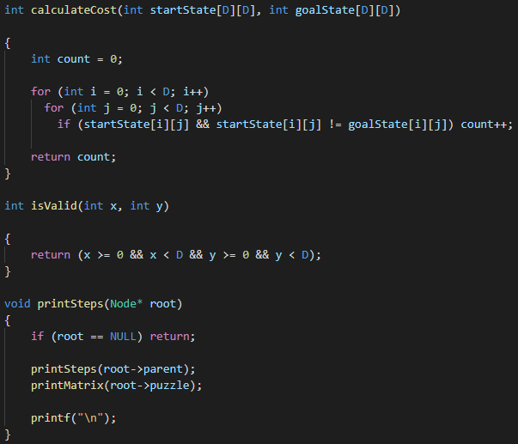
Implementations - Depth First Search
Helper functions were used to perform repetitive tasks:
Calculating cost
Tuple validity
Printing steps

Slide 12
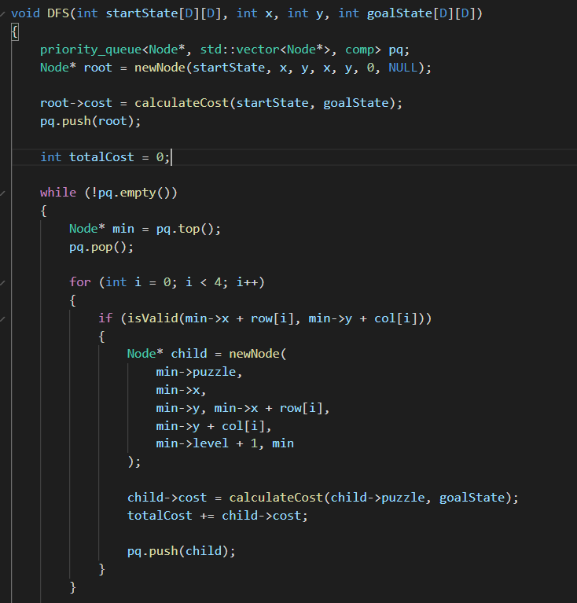
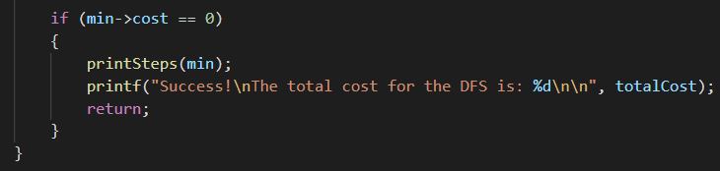
Implementations - Depth First Search

Slide 13
Complexity - Depth First Search
DFS does not make use of any data structure
It gives a complexity of
O(V+E)
V represents the total number of Vertices
E represents the total number of Edges

Slide 14

Implementations - Dijkstra’s algorithm
Dijkstra’s algorithm was implemented using Python
Python allowed for importation of algorithms from multiple libraries
Numpy, Heapify and Heappop is imported

Slide 15
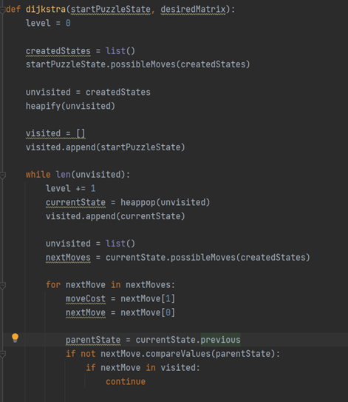
Dijkstra’s algorithm makes use of a list
Puzzle’s moves gets added to the list
The unvisited edges get added to a heap to get the edge with the smallest weight.
The while loop iterates through all the unvisited edges and for every edge used, a level is added.
This edge is then removed from the heap and gets added to the list of visited edges.
Loops through possible next moves and checks for if this node has been visited.

Slide 16
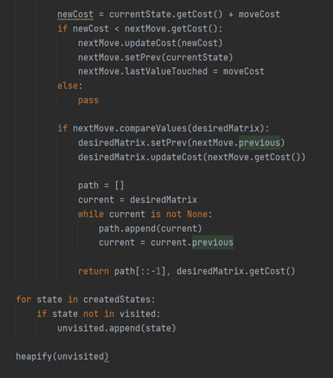
The Dijkstra cost gets updated
If the existing cost is less than the current cost then cost gets updated
The new moves cost is updated and the previous is set to the current state
Every time the while loop runs, the unvisited states get heapified to get the shortest edge that doesn’t form a cycle.

Slide 17
Complexity - Dijkstra’s algorithm
Dijkstra makes use of a heap structure
This heap gives worst case complexity
O(V + ElogV)
V represents the total number of vertices
Log V comes from the heap
E represents the total number of edges.

Slide 18
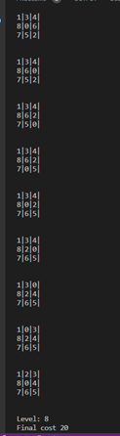
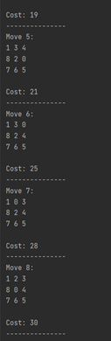



Comparison of results
BFS
Dijkstra
DFS

Slide 19
Conclusion
BFS was overall a better solution considering complexity and number of steps needed to get to the final state

